Slide 1
Customer relationship management

Slide 2
Purpose of CRM
Why we need CRM
Defining CRM
Identifying different customer types
Developing customers i.e. Loyalty programs
A buzz phrase…with meaning
Good CRM has a sophisticated database
Management of customers – don’t have to be passive recipients of their behavior

Slide 3
History of CRM
B&S
RM
CIMS
CRM
e-CRM
Time line
Late 80’s
Early 90’s
Mid 90’s
2002 - Future
B&S – Buying & Selling
RM – Relationship Marketing
CIMS – Customer Information Management Systems
CRM – Customer Relationship Management
e-CRM- A subset of CRM that focuses on enabling customer interactions via e-channels (The web, email and wireless)

Slide 4
Definitions
“is a business strategy with outcomes
that optimise profitability, revenue and customer satisfaction
by organizing around customer segments,
fostering customer-satisfying behaviors and
implementing customer-centric processes.”
“is a strategy
used to learn more about customers' needs and behaviors
in order to develop stronger relationships with them.”

Slide 5
Underpinning Theory
Customers have many points of contact with an organisation
Retaining customers is far most cost effective than recruiting new ones
Some customers are more profitable than others
The “80/20” rule
For most firms, 80 percent of profit comes from 20 percent of customers
Use of Technology

Slide 6
An example
The Elements of CRM
Sales force automation
Customer service/call center management
Marketing automation
Call center telephone sales
Call Centers
Managing aspects
Of customer contact
Campaign
management
E-commerce
Field sales
Web-based
self service
Content
management
Retail
Field services
and dispatch
Data analysis
And business
Intelligence tools
Third-party brokers,
Distributors, agents
Data warehouse and data cleaning tools

Slide 7
Potential Benefits Of CRM
Customer retention
Share of customer or share of wallet
Cross-selling
Up-selling

Slide 8
Potential Costs Of CRM
IT infrastructure
Process change

Slide 9
Benefits Of CRM For Customers
Continuity
A contact point
Personalisation

Slide 10
Three phases of CRM
Acquiring New Relationships
You acquire new customers by promoting your company’s product and service leadership.
Enhancing Existing Relationships
You enhance the relationship by encouraging excellence in cross-selling and up-selling, thereby deepening and broadening the relationship.
Retaining Customer Relationships
Retention focuses on service adaptability – delivering not what the market wants but what customers want.

Slide 11
Steps to improve CRM
Build a database
Analyse, define types, profitability
Customer selection
Activities to delight selected customers - discourage others
Analyse again to see how we’re doing

Slide 12
What should be in the database
Demographics
How do you get people to provide this?
History of contacts
Transaction history or summary
Response to marketing communications
How did you hear about us (this offer?)

Slide 13
Behavioral Patterns
Behavioral patterns
Consumption channel
Benefit segments
Degree of loyalty
Permission

Slide 14
Analytically Derived Segments
Analytically derived
On-line analytical processing (OLAP)
Customer lifetime value
Intangible benefits

Slide 15
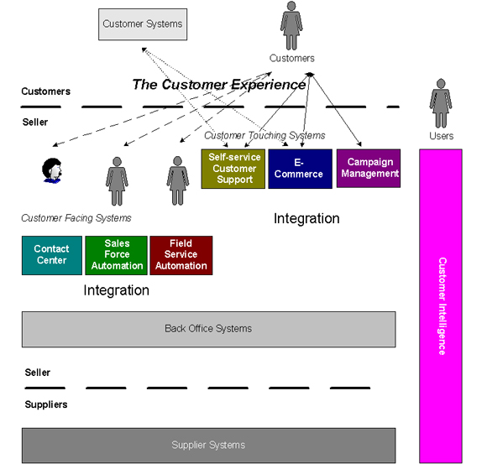
CRM Applications

Slide 16
Customer Types
Platinum Heavy, reliable users, not price-sensitive, try new products, loyal
Gold Large users who push for price breaks, shop around and not so loyal
Iron Low volume or intermittent users; cost to serve them is quite high
Lead Demanding, want special attention but don’t buy much and show no loyalty

Slide 17
Advantages of CRM
While company is quickly growing, customers are more satisfied as well
Service provided in a better way, and a quicker way
Sales force automated
Integrated customer information
Certain processes eliminated
Operation cost cut, and time efficient
Brand names more quickly established
A central database so that everyone in your company can keep track of customer contacts
Sales and marketing teams can benefit from having all this inside knowledge about customers
Lets you set up rules for distributing work throughout your company
Lets you pick and choose the functionality that you want

Slide 18
Disadvantages:
-Organizational wise change of priority to customers.
- Significant investment of time and money
- Threatens management’s control/power struggle
- Heightens people’s resistance to change
- Inappropriate integration leads to disaster

